Slide 1




SummarEase
A Text Summarizer
By Malita Lewis
(TYBCA)

Slide 2


Agenda
Problem Definition
Screenshots
Objectives
Limitation
Conclusion
System Architecture

Slide 3

Problem Definition
Information Overload
Storage
Navigating Data
Time-Consuming Process
Complex Data
Difficult to Grasp
Challenge for Decision Making
Duplicate Data

Slide 4

Objectives
To save users time by condensing lengthy text efficiently.
To allow users to identify and extract key points swiftly.
To enable users to digest information rapidly.
To provide rapid access to summarized information.
To improve user efficiency in handling extensive documents.
To ensure user can quickly grasp essential information.

Slide 5

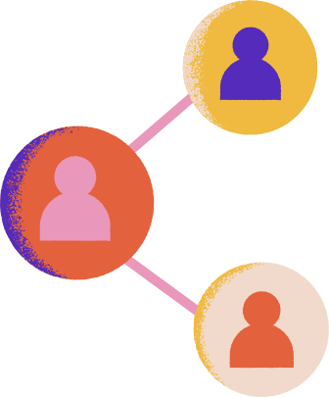
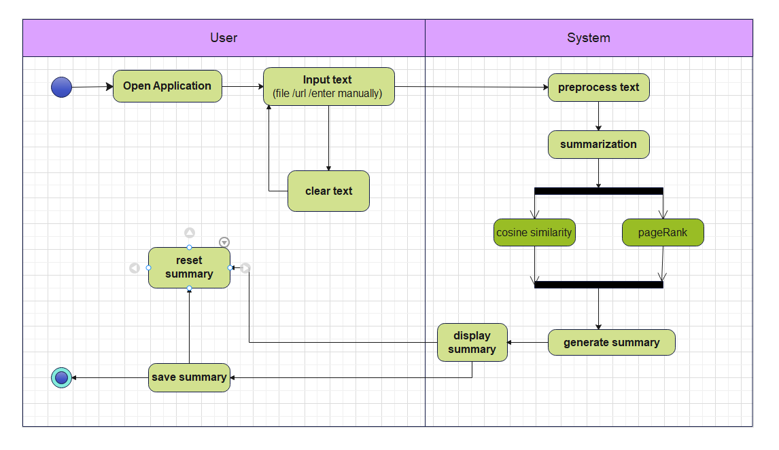


System Architecture
Activity Diagram

Slide 6
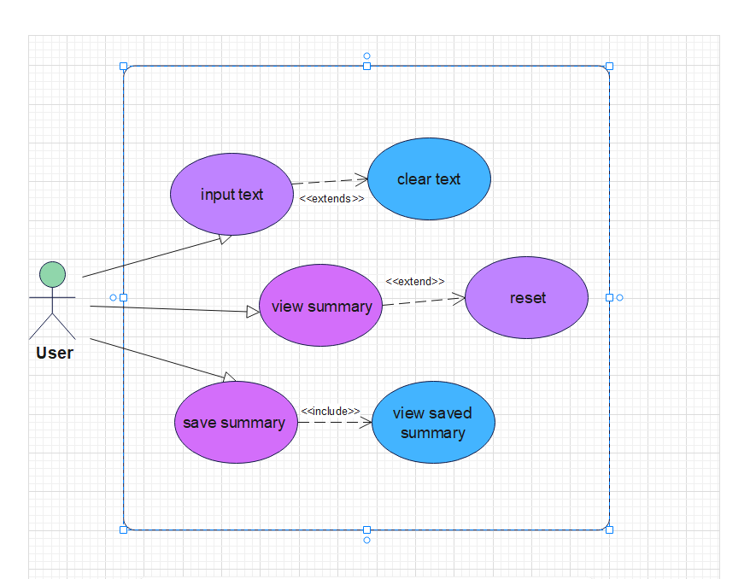
System Architecture
UseCase Diagram

Slide 7
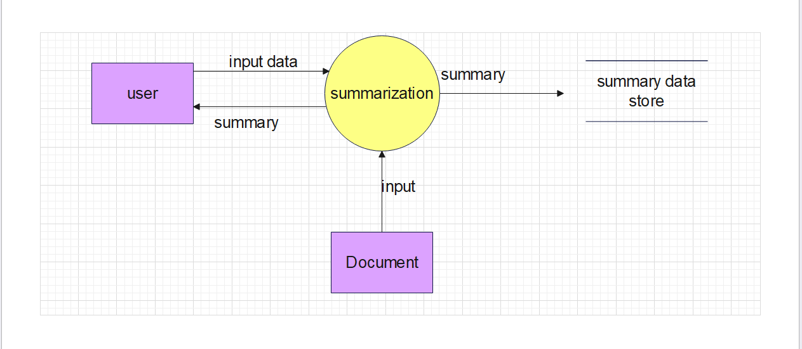
System Architecture
0 Level Data Flow Diagram

Slide 8
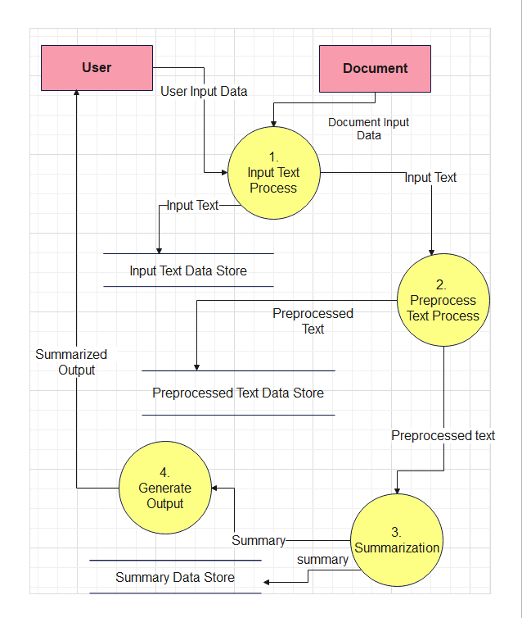
System Architecture
1 Level Data Flow Diagram

Slide 9
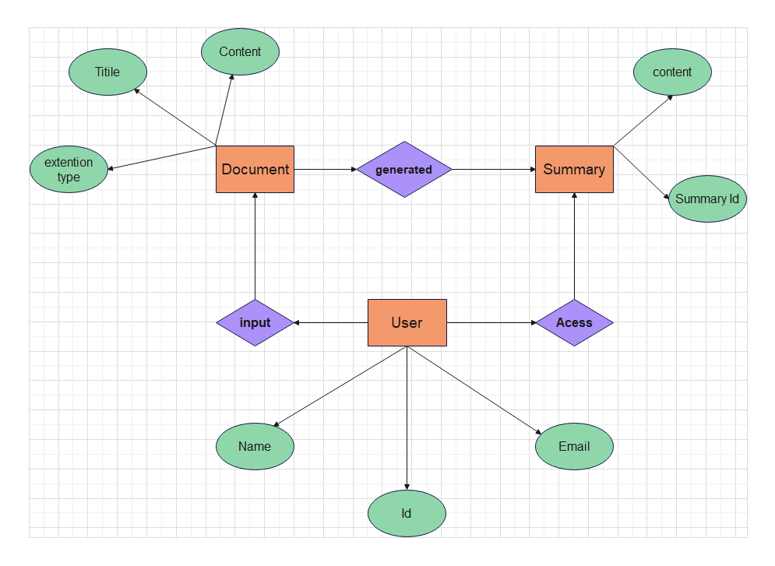
System Architecture
ER Diagram

Slide 10
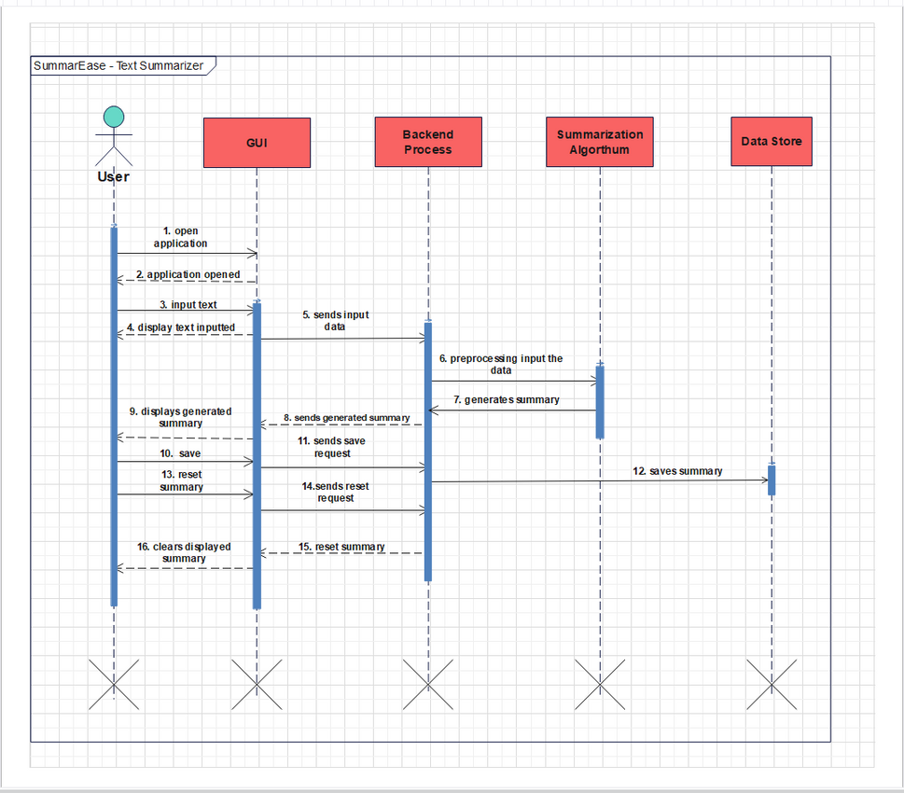
System Architecture
Sequence Diagram

Slide 11
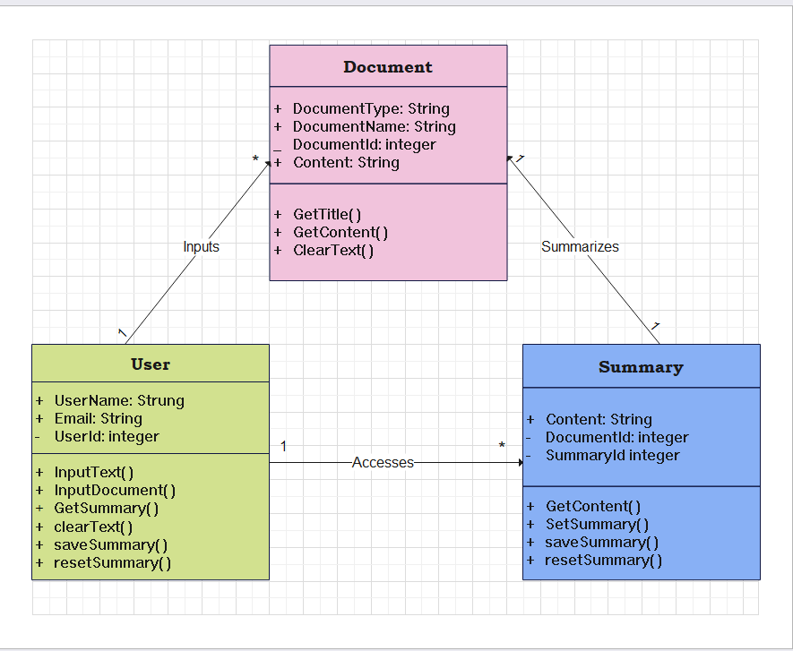
System Architecture
Class Diagram

Slide 12
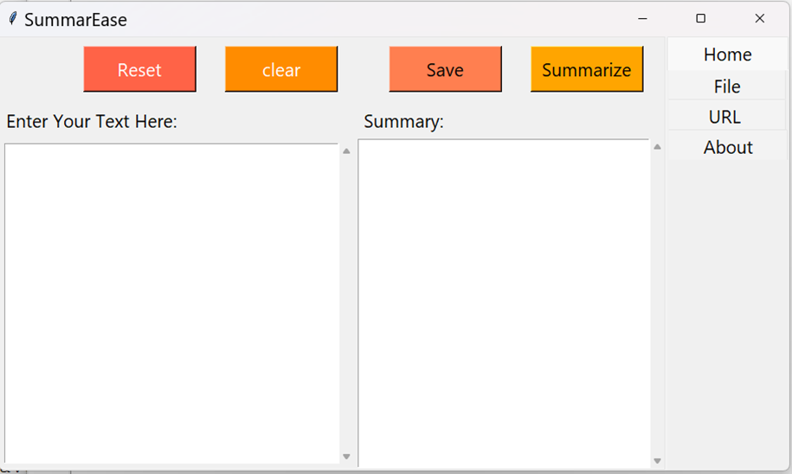
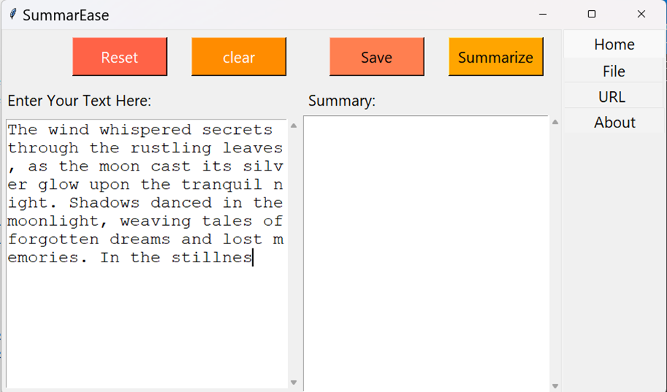
ScreenShots
➢ When you open the app by default home page is opened
➢ Here you can manually type your text or paste your copied text

Slide 13
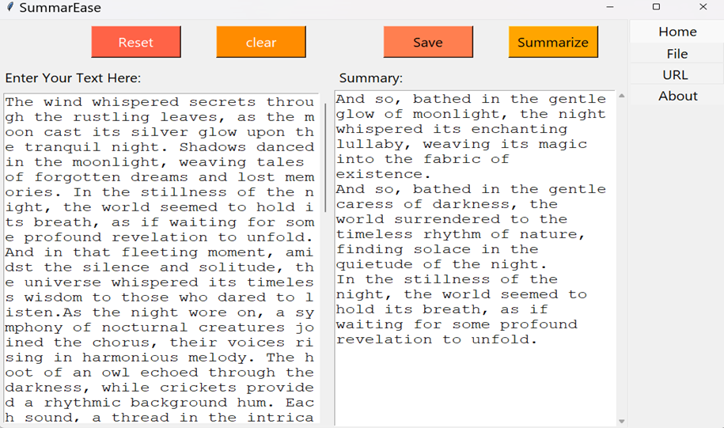
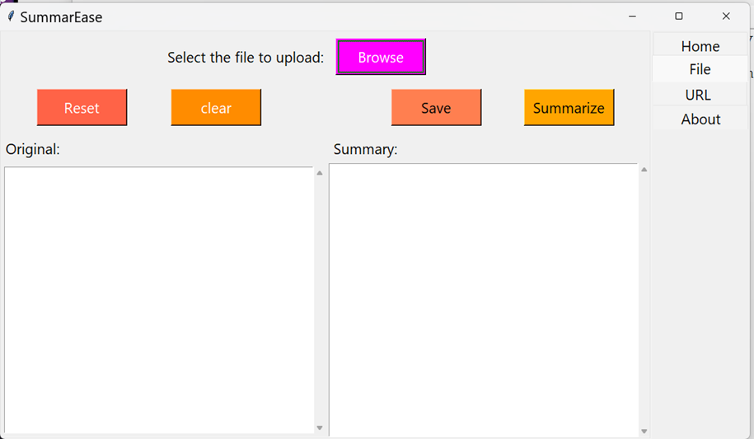
ScreenShots
➢ After clicking summary button , summary is generated
➢ If you wish to summarizer a file , go to the file tab

Slide 14
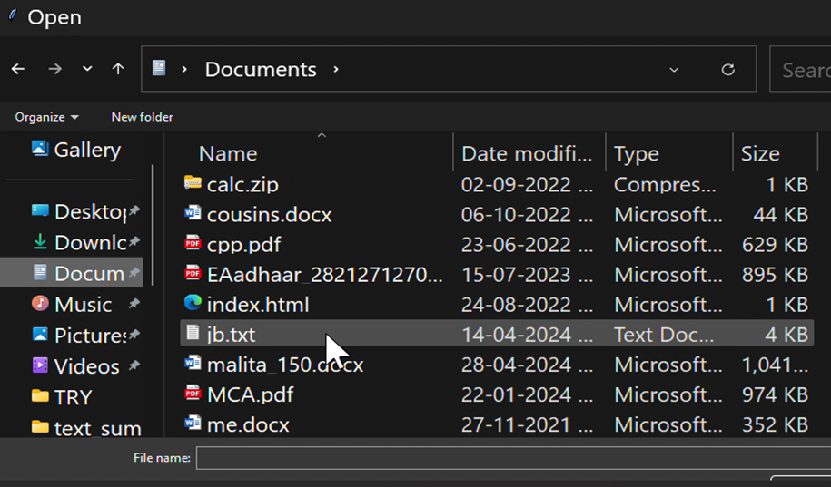
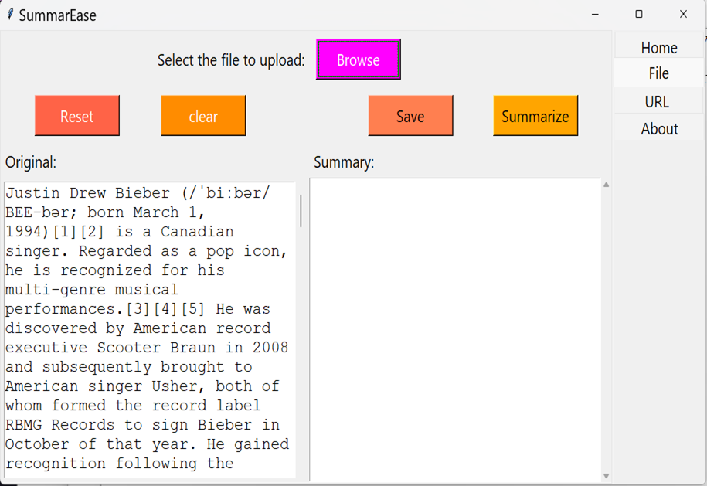
ScreenShots
➢ Click the browse button & select the desired file(only ppt, docx, pdf & txt )
➢ Once the file is selected contents of the file is displayed

Slide 15
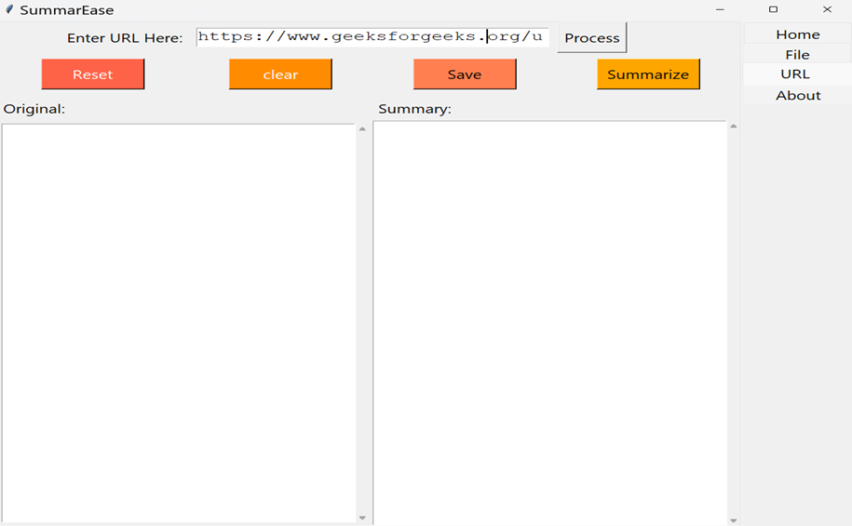
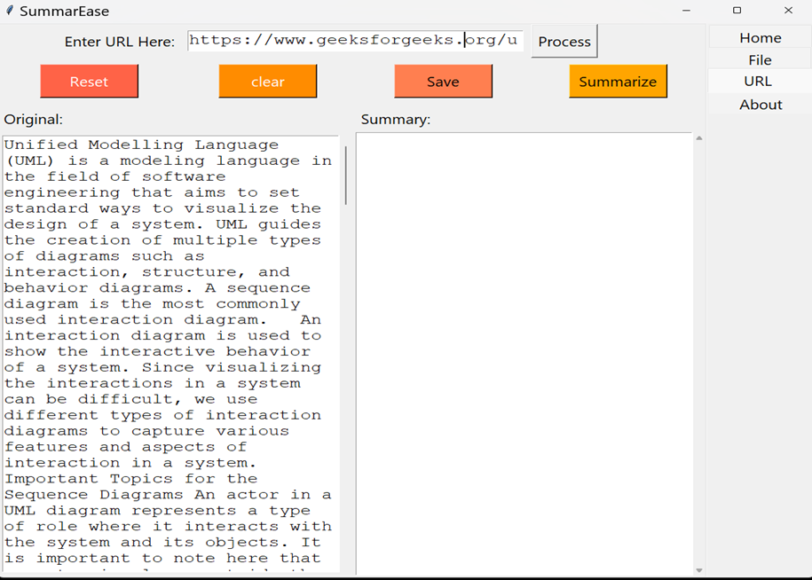
ScreenShots
➢ Go to the url tab & enter your url
➢ After clicking process button , contents of the url is displayed

Slide 16
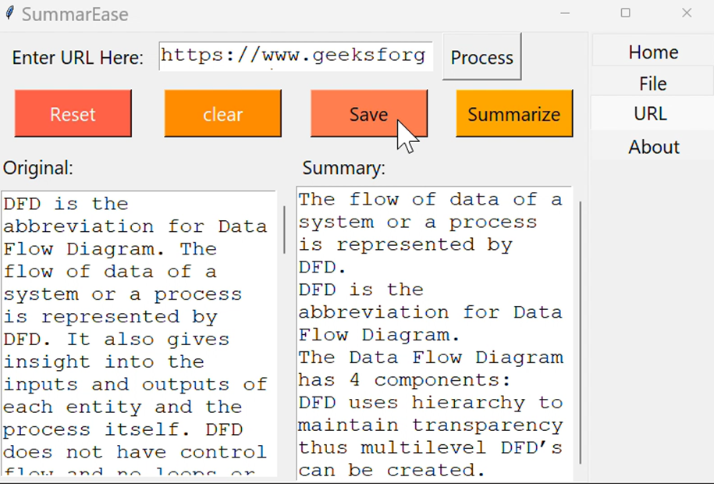
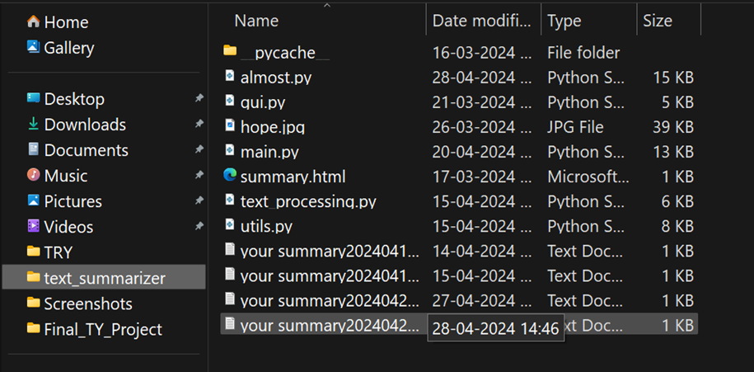
ScreenShots
➢ To save, click on the save button
➢ Summary is saved on your computer under the title ‘your summary’

Slide 17
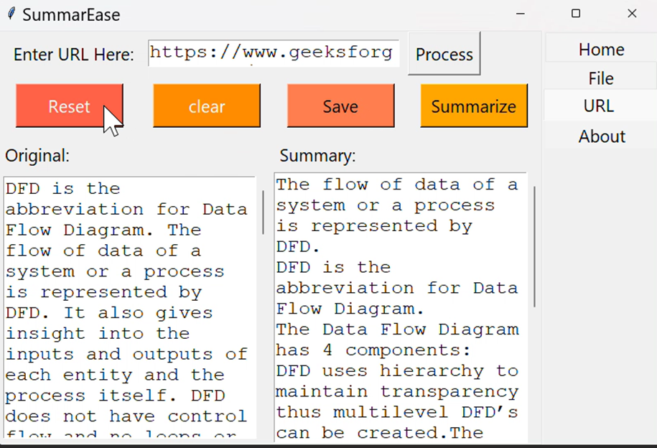
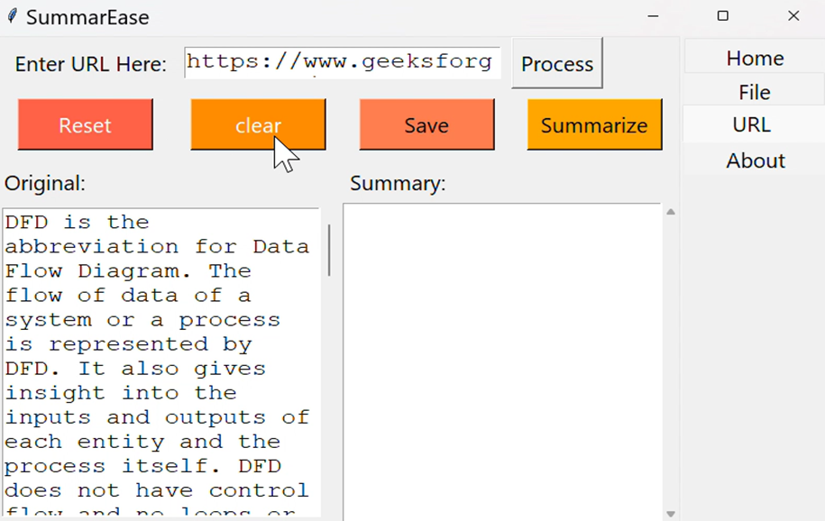
ScreenShots
➢ To Reset summary , click reset button
➢ To Clear input text , click clear button

Slide 18



limitations
Language Dependency
only supports english
Ambiguity Handling
one sentence may have two different meanings
Lengthy Documents
processing lengthy documents maybe a challenge for performance
Variability in Quality
quality of summary may depend upon input text clearity and relevance
Loss of Context
actually meaning of the sentence might be lost

Slide 19




Conclusion
“SummarEase” condenses large volumes of data into compact summaries
Pinpoints and prioritizes crucial information
Saving time , makes it easier to grasp information

Slide 20



Thank you !!

